Slide 1

Twitter Sentiment Classification
Predictive data mining
Iyanuoluwa Shode

Slide 2
Sentiment Analysis
This analysis is a supervised classification model that detects people’s sentiments or opinion about a product, an event, or societal issue such as elections, racism, social media, government policies and so on. Sentiment analysis is a predictive analysis that foretells the changes in the phenomenon of interests.
Data analysts in major organizations uses sentiment analysis in gauging public sentiment, doing detailed market research, monitoring brand and product reputation, and comprehending customer experiences. Companies use this analysis to predict the sales of their products based on the analysis of the negative or positive reviews garnered from their consumers. Also, who wins elections can be easily predicted by examining the opinions of the electorates.
In this analysis, a classifier is built and fed a text that returns a category which could be positive, negative, or neutral.

Slide 3
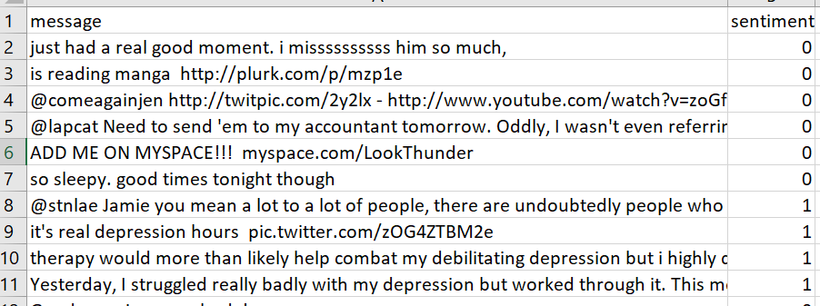
The Dataset
This assignment focuses on a popular social media platform, Twitter. Twitter is an interactive application where its users share their opinions regarding several topics across the globe.
The dataset used for this assignment was obtained from Kaggle. Manas Garg, the originator of this dataset compiled a CSV file of over 10000 tweets in order to be able to detect the state of the mental health of Twitter users. The CSV file contains the annotated text that is labelled with 0 and 1. 0 means positive sentiment to show that the user is in a stable mental state while 1 means negative sentiment which denotes depression.

Slide 4
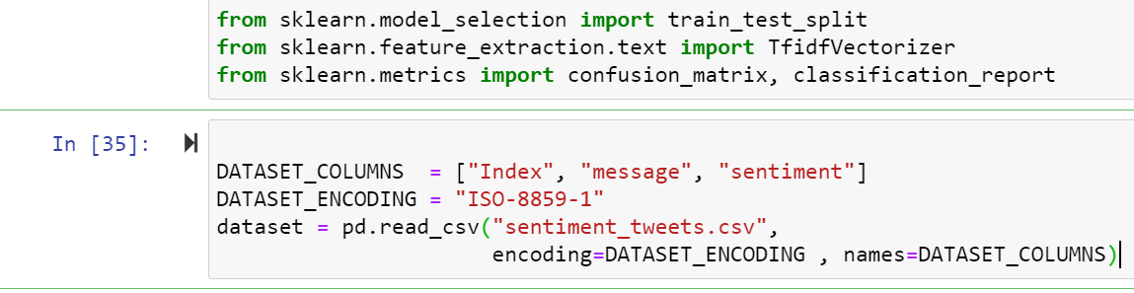
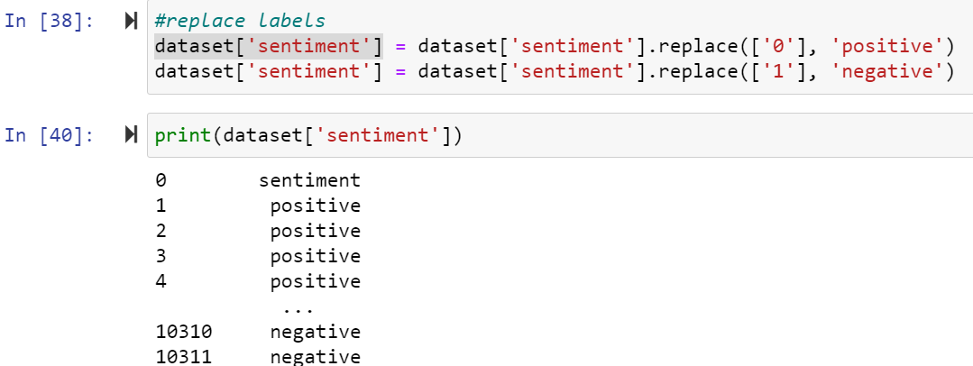
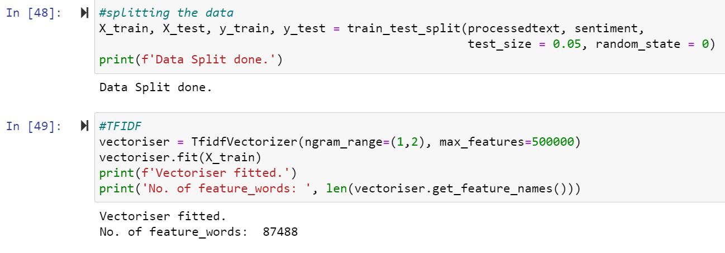
Data Preprocessing/Analysis
After importing the necessary python packages, dependencies and the dataset, the next step was data preprocessing where the unnecessary stop words, usernames, urls, non-alphanumeric characters were removed. Followed by the lemmatization step which converted the words to their base forms.
The dataset was split into two – training and test set. Then, TFIDF Vectorization took place to show the importance of the word in a document into consideration.

Slide 5
Classification Models
Three classifying models were built in order to analyze the dataset. The classification models used were:
Bernoulli Naive Bayes (BernoulliNB)
Linear Support Vector Classification (LinearSVC)
Logistic Regression (LR)
These models showed the precision, recall and f1-score metrics. Confusion matrix displayed how our models performed. It shows where the model performs well and where it underperforms. For example, the BernoulliNB confusion matrix is informative since it shows that all the misclassifications occur as false negatives and never as false positives (when in doubt, it just predicts negative).

Slide 6
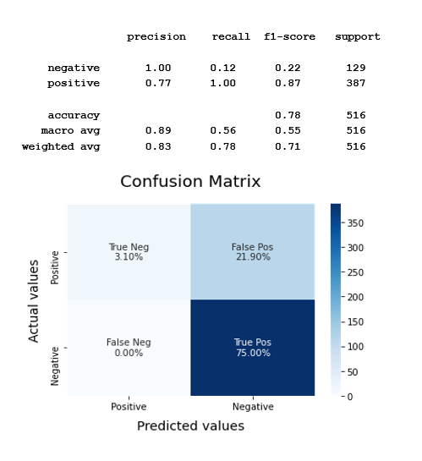
Bernoulli Naive Bayes (BernoulliNB)

Slide 7
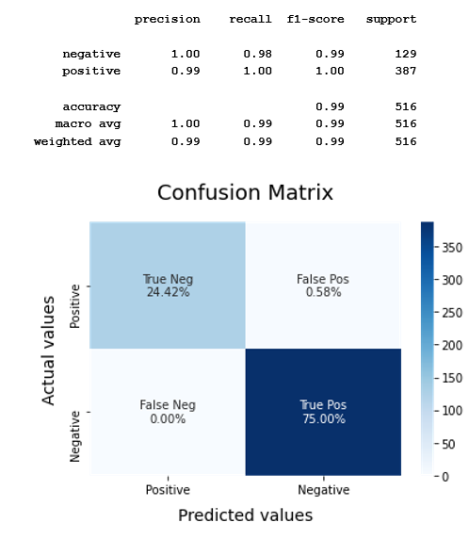
Linear Support Vector Classification (LinearSVC)

Slide 8
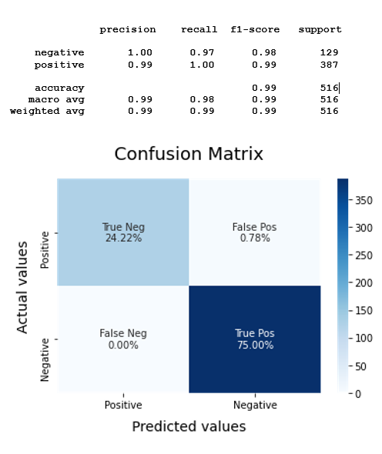
Linear Regression

Slide 9
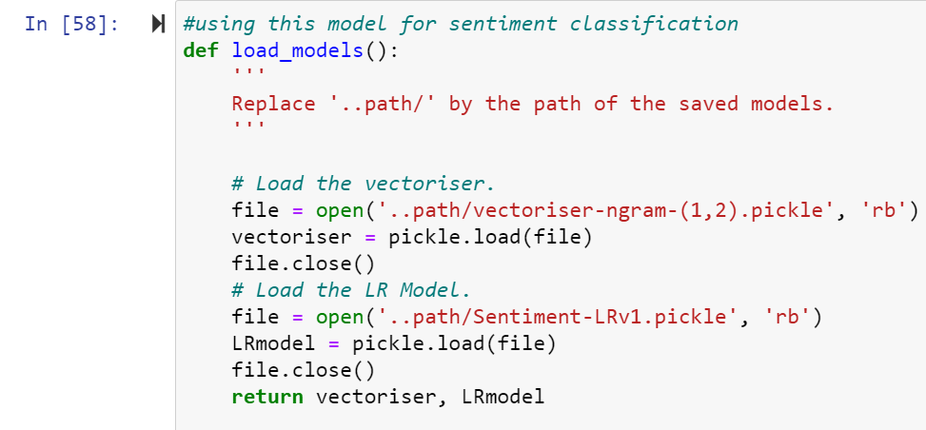
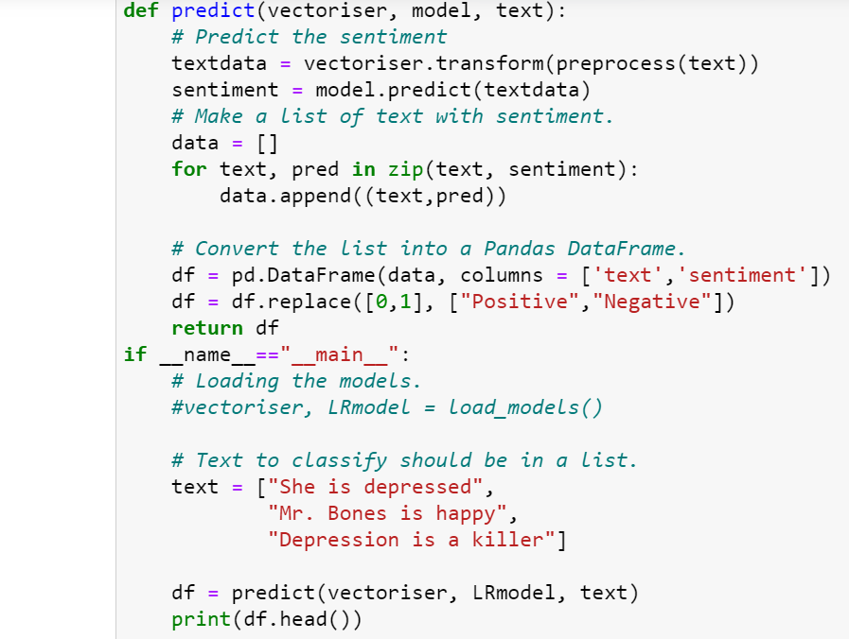
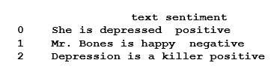
Model Predictions
To get sentiments for future predictions, the Vectoriser and LR Model using Pickle were imported to save the model and classify the new input data.
The result can be seen below:

Slide 10
References
Garg, M. (2021). Sentiment Analysis for Tweets. Retrieved November 16 2021, from
https://www.kaggle.com/gargmanas/sentimental-analysis-for-tweets
Lexalytics. Sentiment Analysis Explained Retrieved November 17 2021, from https://www.lexalytics.com/technology/sentiment-analysis
Roy, A. (July 10, 2020). A Guide to Text Classification and Sentiment Analysis. Retrieved November 16 2021, from
https://towardsdatascience.com/a-guide-to-text-classification-and-sentiment-analysis-2ab021796317
Luvsandorj, Z. (Sep 11, 2020). Sentiment classification in Python. Retrieved November 18 2021, from
https://towardsdatascience.com/sentiment-classification-in-python-da31833da01b

Slide 11
References
Mesevage, T. (April 30, 2020). Sentiment Classification – The Low-Down. Retrieved November 18 2021, from
https://monkeylearn.com/blog/sentiment-classification/
Smailovic, J et.al. (2013). Predictive Sentiment Analysis of Tweets: A Stock Market Application Retrieved November 17 2021, from https://link.springer.com/chapter/10.1007/978-3-642-39146-0_8

